Slide 1
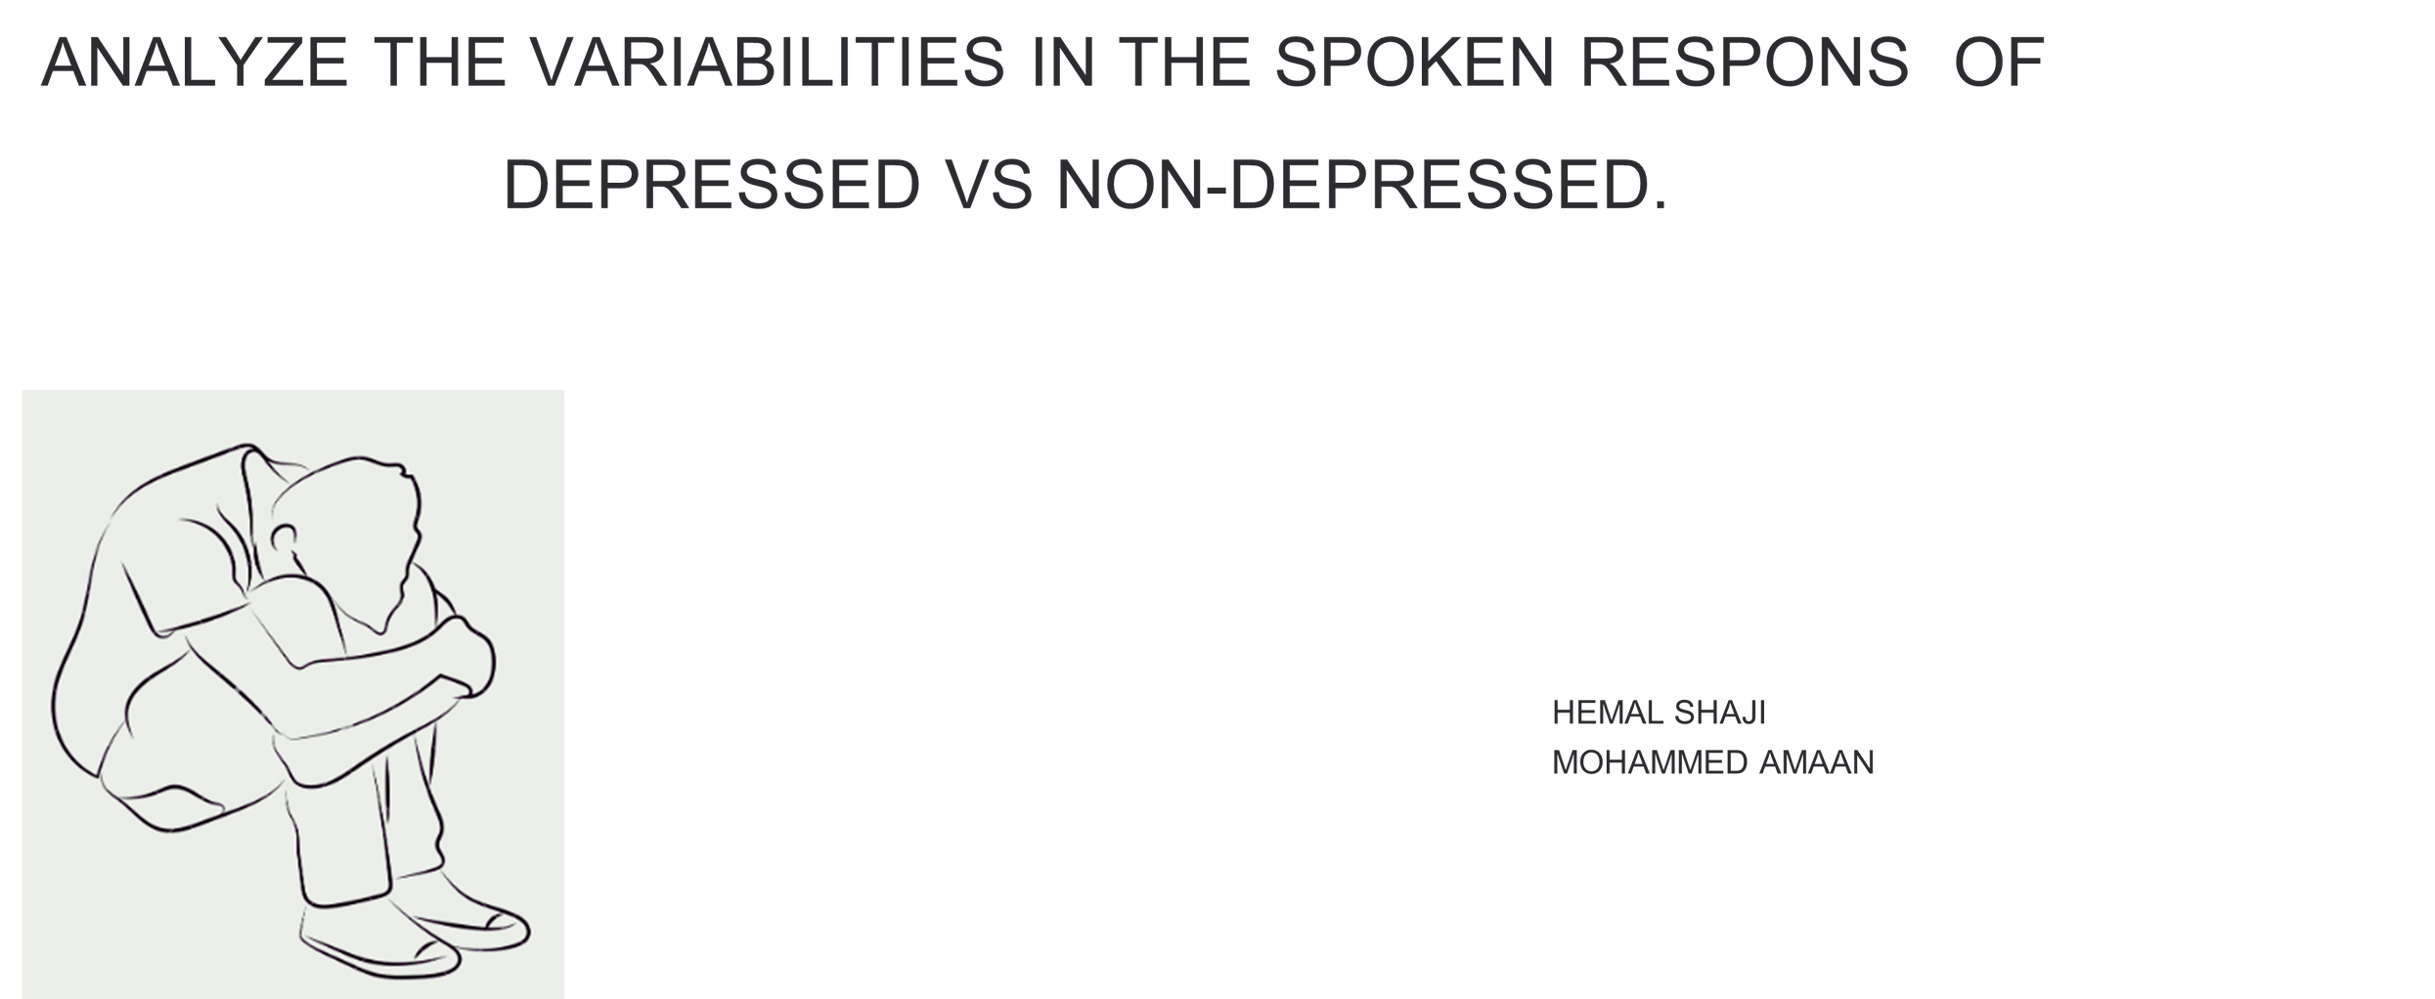

Slide 2
DATA COLLECTION
•People in the age group of 18 - 35
• participants were classified into five depression severity categories based on their PHQ-9 score
• None: 39 participants
• Mild: 63 participants
• Moderate: 36 participants
• Moderately Severe: 7 participants
• Severe: 4 participants
•They have selected 15 words (three from each of the five ANEW categories)
-They has stored the transcript of each audio responses.

Slide 3
TASK FOR PARTCIPANTS
1) Affective Rating Task
Participants viewed each word and rated their valence and arousal 9 point Likert scale
The SAM scale served as a visual aid for self reported valence and arousal ratings
2)Property Generation Task
Participants verbally de scribed their thoughts, feelings, and memories evoked by each word
for a minimum of 20 seconds. They were presented with 15 such words. They were instructed
to avoid single words, phrases, or definitions, Before the experiment, participants received an
example word and spoken response to familiarize them with the task
3)Mental Health Survey
Participants completed the Patient Health Questionnaire (PHQ-9). Participants read each
statement and selected the response that best described their current state of mind. The
PHQ-9 score was obtained by summing the ratings of its 9 items (0-3 scale).

Slide 4
DATASET-2 DIAC-WOZ
This database is part of a larger corpus, the Distress Analysis Interview Corpus (DAIC) (Gratch et al.,2014), that contains clinical interviews designed to support the diagnosis of psychological distress conditions such as anxiety, depression, and post-traumatic stress disorder. These interviews were collected as part of a larger effort to create a computer agent that interviews people and identifies verbal and nonverbal indicators of mental illness (DeVault et al., 2014). Data collected include audio and video recordings and extensive questionnaire responses s; this part of the corpus includes the Wizard-of Oz interviews, conducted by an animated virtual interviewer called Ellie, controlled by a human interviewer in another room. Data has been transcribed and annotated for a variety of verbal and non verbal features.

Slide 5
DEPRESSION DETECTION FROM TEXT
Hypothesis:
Non-depressed individuals use more positive words in their text responses, while depressed individuals tend to use more negative words. Therefore, analyzing sentiment scores and word counts can help distinguish between these two groups.
Non-depressed individuals exhibit higher valence (positivity) and arousal scores (ranging from calm to excited), while depressed individuals exhibit lower scores (calm to subdued). These differences in emotional expression can help distinguish between the two groups.
Using LLM models, sentiment scores capture emotional nuances better than traditional methods, enhancing the detection of depressive language patterns and distinguishing between depressed and non-depressed individuals.
To assess emotional variability in text from audio, categorize words into HVHA and LVLA groups and analyze their frequency and context. Depressed individuals often show less variability in emotional expressions, with frequent low-arousal words suggesting reduced emotional range and possible depression

Slide 6
SENTIMENT ANALYSIS

Slide 7
VEDAR
VADER (Valence Aware Dictionary and Sentiment Reasoner) is used for analyzing sentiment in text, determining how positive, negative, or neutral the text is.
VADER provides sentiment scores from -1 (most negative) to +1 (most positive), allowing you to gauge the emotional tone of the text.

Slide 8
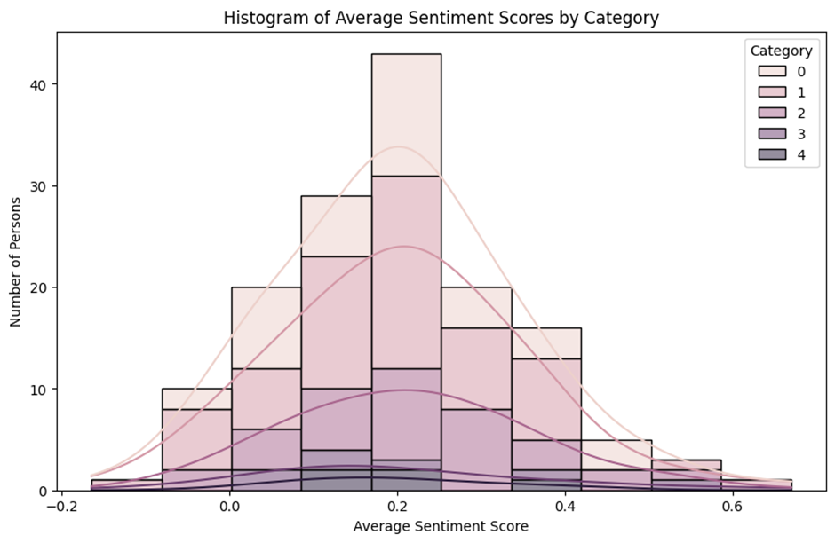
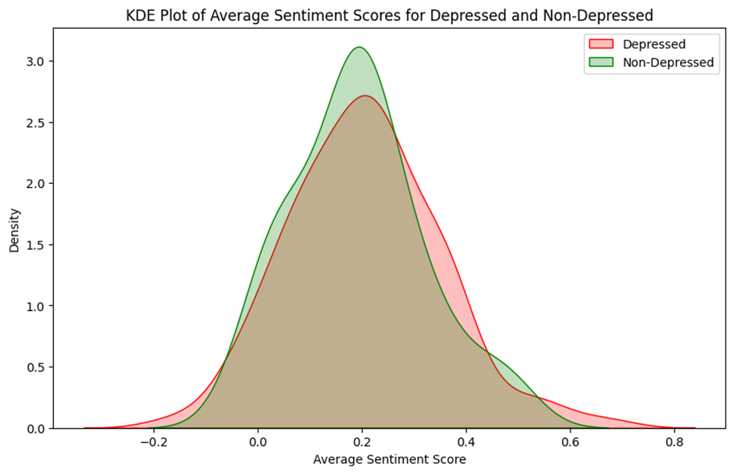
AVG SENTIMENT SCORE-5 CATEGORY
KDE FOR AVERAGED DEPREESED AND NON DEPPRESSED
They have already conducted phq 9 test between the every participant.
5 Categories based on phq 9
We have taken the average that is by
sum of 15 sentence scores of each person/15
Averaged sentiment score
Classified into 2 categories depressed and non depressed

Slide 9
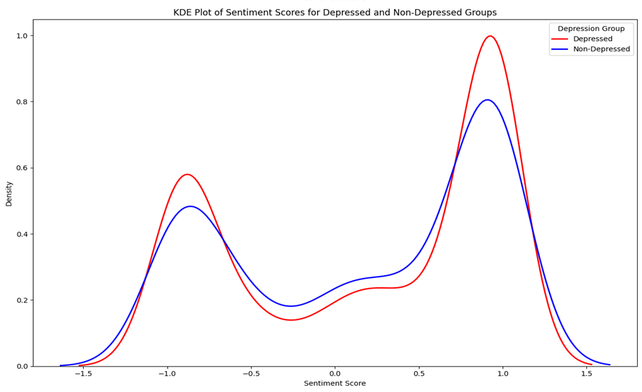
KDE FOR DEPRESSED AND NON-DEPRESSED GROUP FOR EVERY SENTENCE SENTIMENT SCORE
Both groups have two main peaks, suggesting two common sentiment ranges for each group.
The depressed group (red) has a higher peak around 1.0, indicating more instances of moderately positive sentiment compared to the non-depressed group.
The non-depressed group (blue) has a slightly higher and wider distribution in the middle range (around 0), suggesting more neutral or mixed sentiments.
Both groups have a smaller peak around -1.0, representing negative sentiments, but this peak is slightly higher for the depressed group.

Slide 10
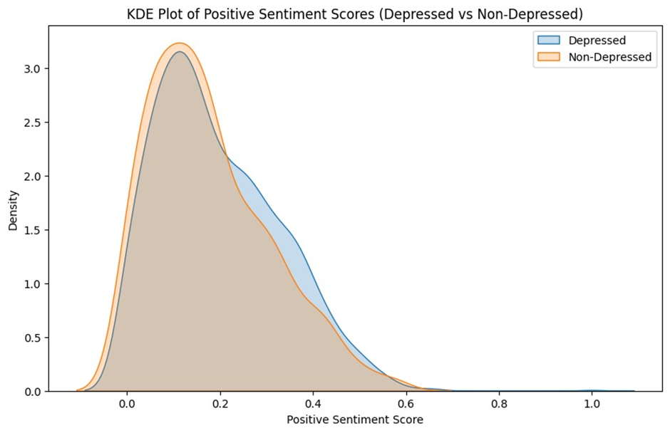
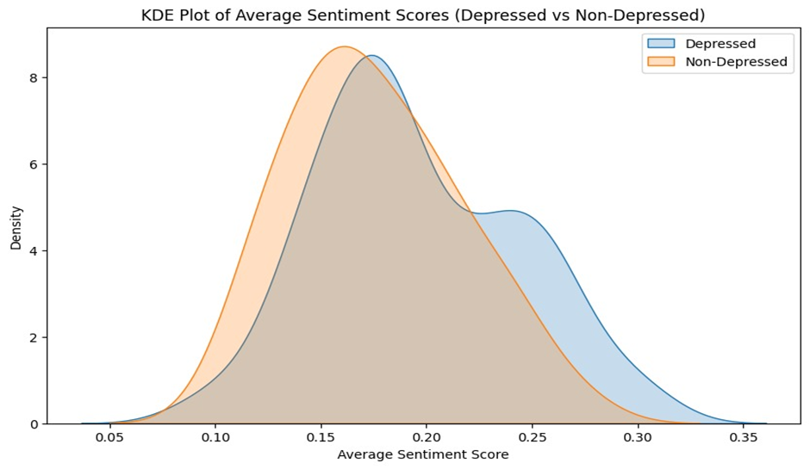
POSITIVE SENTIMENT SCORE
1st graph shows the positive sentiment score for each sentences
2nd graph shows the averaged positive score that is by taking the sum of 15 score of each person and divide it by 15
in this both graph we are unable to distinguish depressed and non-depressed based on positive score

Slide 11
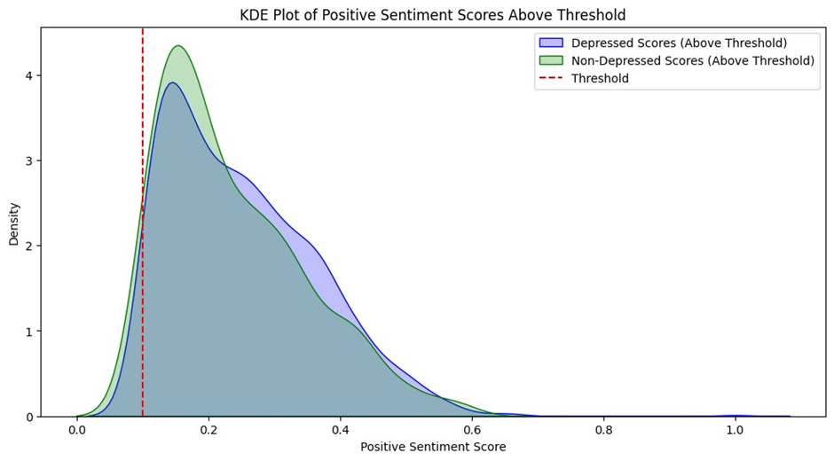
THRESHOLD OF 0.1 FOR POSITIVE SENTIMENT SCORE FOR ALL SENTENCE
This graph shows the distribution of positive sentiment scores above a certain threshold 0.1.
The non-depressed group (green) has a higher and narrower peak just after the threshold.
The depressed group (blue), while having a lower peak, still shows a wider distribution extending into higher positive scores.They can still experience a range of positive emotions, sometimes even of higher intensity than the non-depressed group.

Slide 12
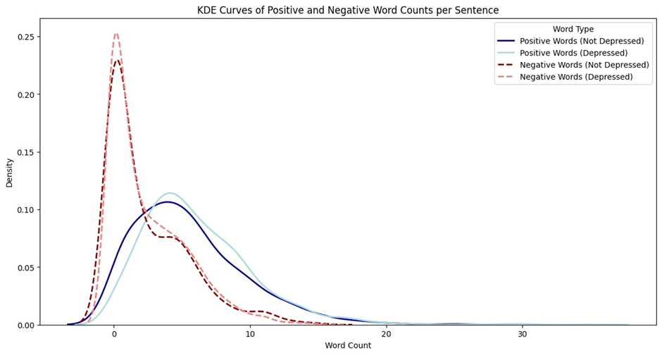
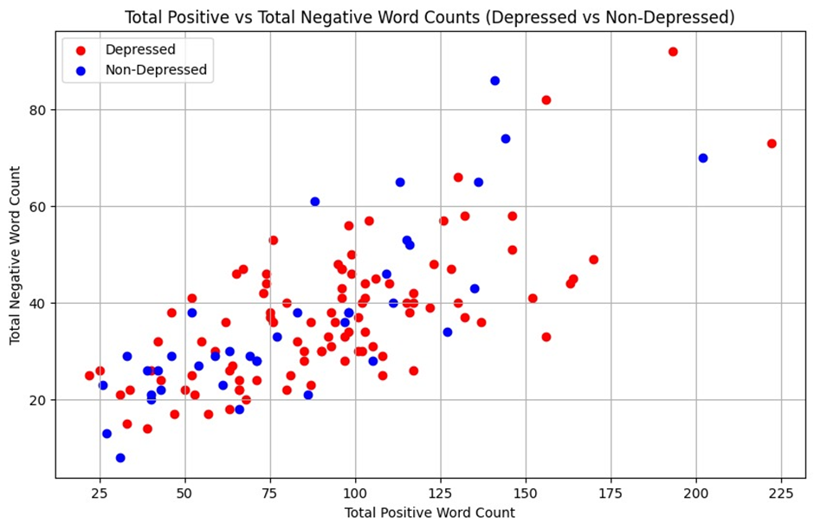
POSITIVE AND NEGATIVE WORD COUNT
1st graph show positive and negative word count per sentences
2nd graph show the total positive and negative word count per person that is taking the sum of count of 15 sentences of each persons
here also both peaks are overlapping at same point so we are unable to distinguish between depressed and non- depressed by looking the graph

Slide 13
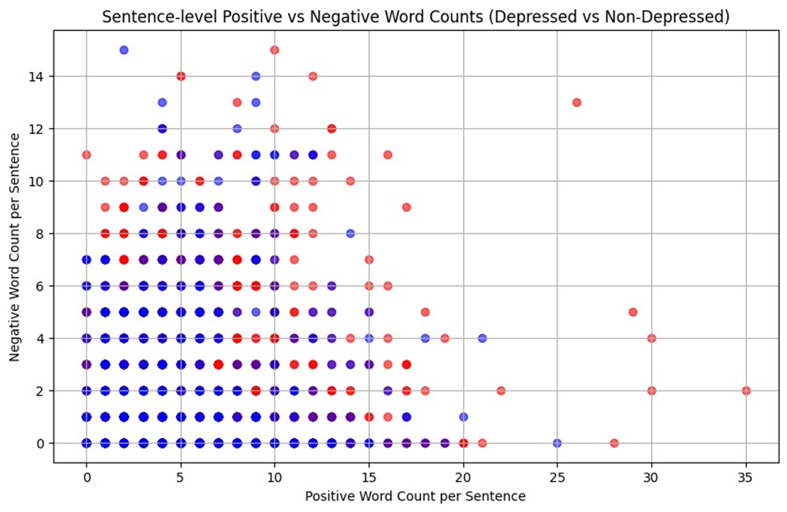
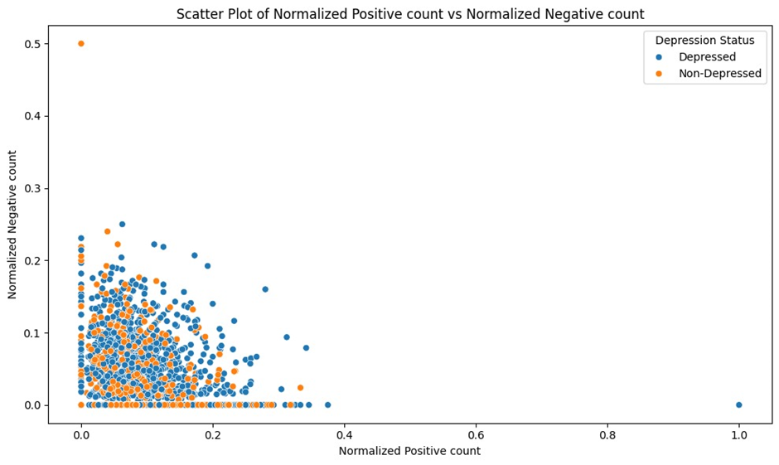
POSTIVE VS NEGATIVE COUNT PER SENTENCE
1st graph show the positive vs negative count of each sentences using Scatter plot
2nd graph show the normalized form of positive and negative count using scatter plot
both graphs overlap significantly,we cannot find any relation for depressed and non-depressed groups.

Slide 14
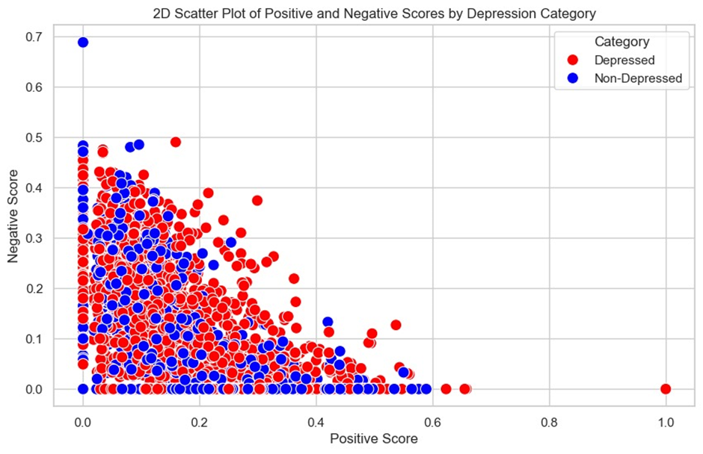
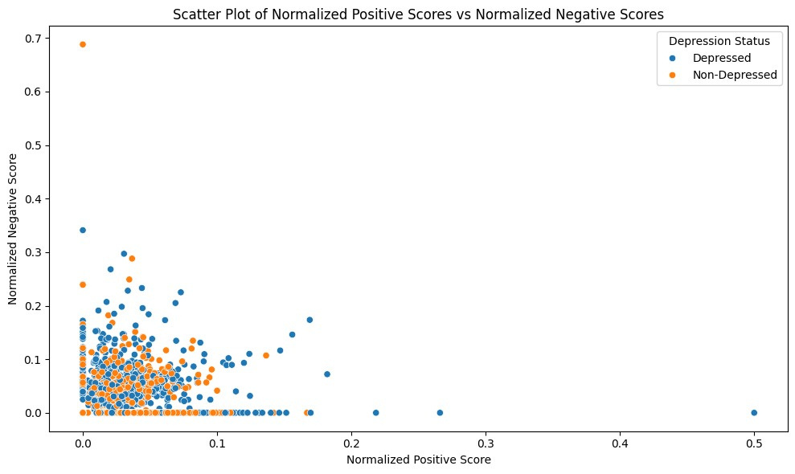
POSITIVE VS NEGATIVE SCORE
1st graph show the positive vs negative score of each sentences
2nd graph show the normalized form of positive and negative score
normalized score = score/positive word count + negative word court
There's significant overlap between the two groups, indicating that depression can't be perfectly determined by these scores alone.

Slide 15
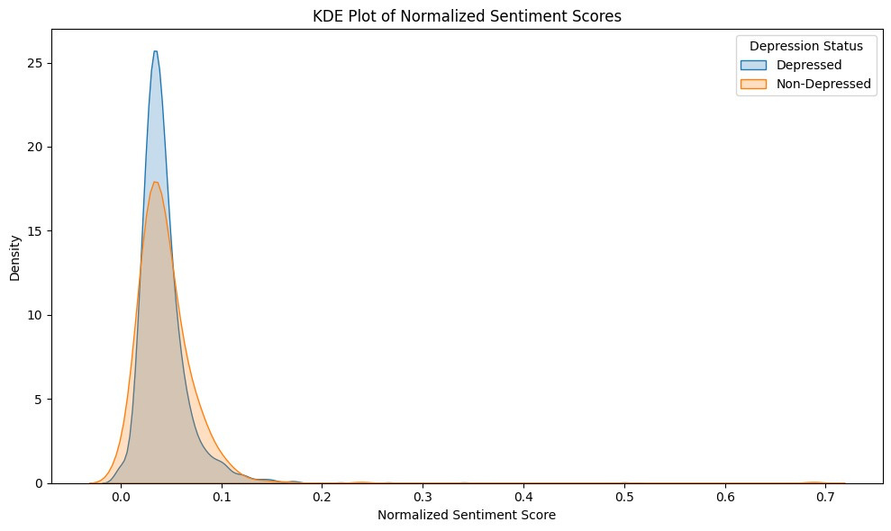
NORMALIZED SENTIMENTAL SCORE PER SENTENCE
Both depressed and non-depressed groups have similar overall distributions of sentiment scores.
The peak for depressed individuals (blue) is slightly higher and narrower, indicating more concentrated sentiment scores.
Non-depressed individuals (orange) show a slightly wider distribution, suggesting more variability in sentiment.

Slide 16
TEXTBLOB
TextBlob is a simple and easy-to-use library for processing text data, including sentiment analysis.
Polarity Score: Ranges from -1 to 1. A score of -1 indicates the most negative sentiment, 0 indicates neutral, and +1 indicates the most positive sentiment.

Slide 17
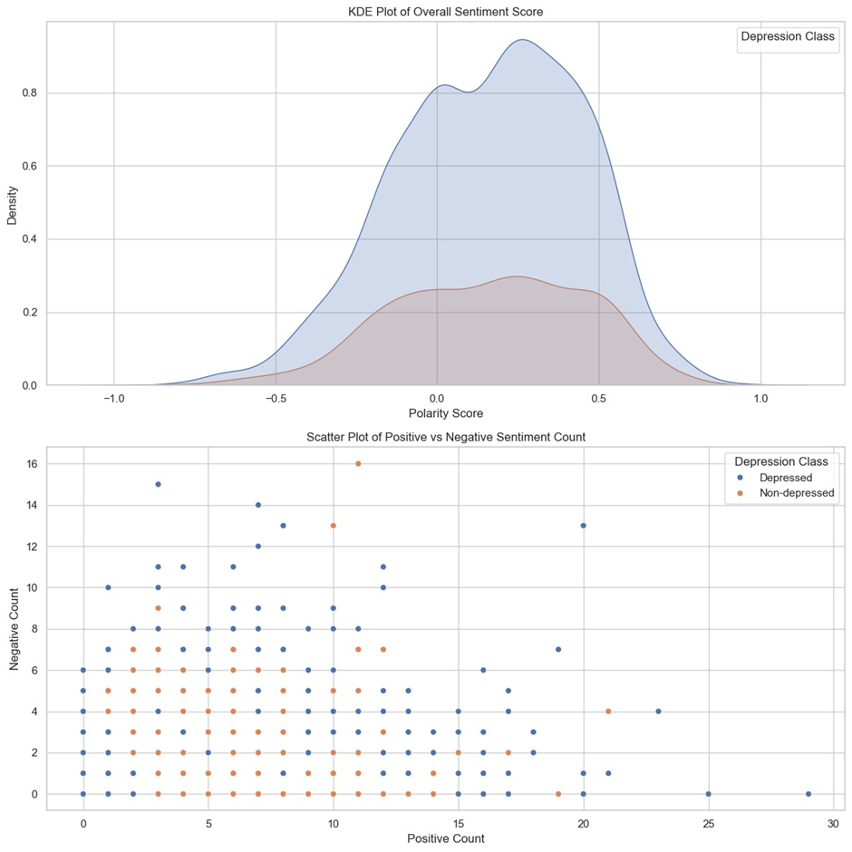
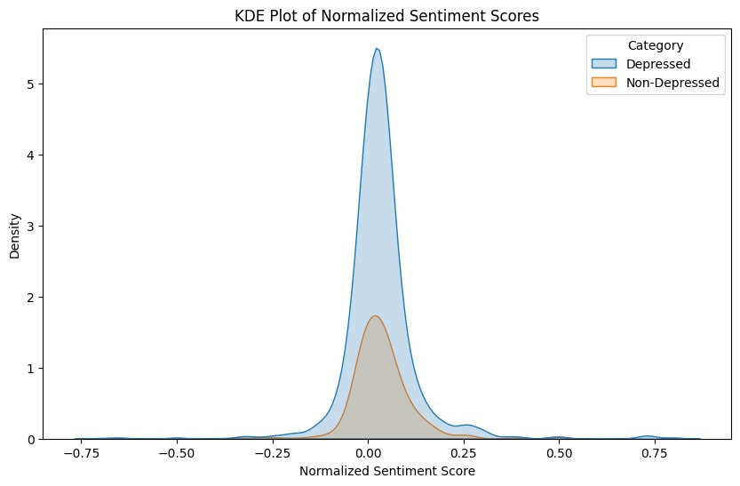
SENTIMENT SCORE PER SENTENCE
1st graph show sentiment score per each sentences
2nd graph show the normalized score

Slide 18
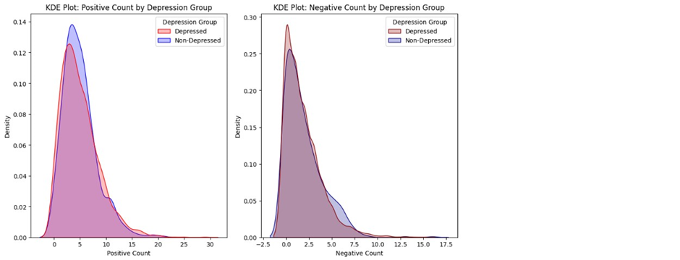
POSITIVE VS NEGATIVE COUNT PER SENTENCE
1st graph show the positive vs negative count of each sentences using Scatter plot
2nd graph show the normalized form of positive and negative count using Kde plot
both graphs overlap significantly,we cannot find any relation for depressed and non-depressed groups.

Slide 19
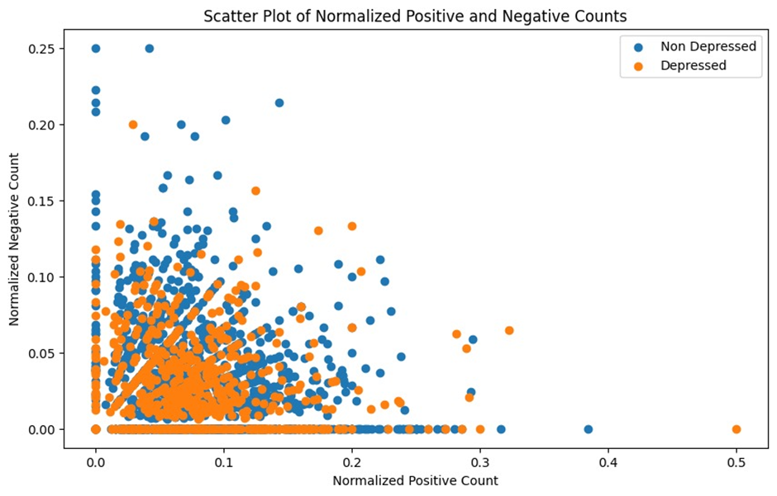
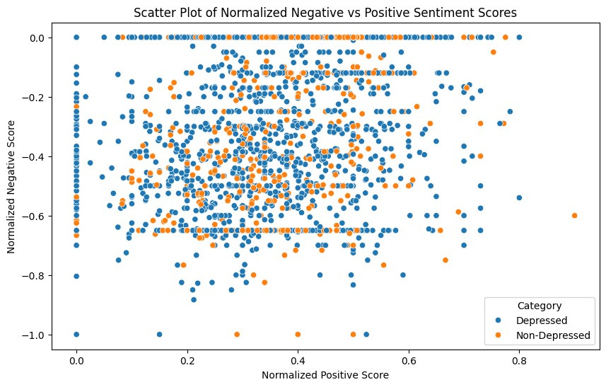
NORMALIZED POSITVE AND NEGATIVE COUNT AND SCORES
1st graph is normalized positive count
2nd graph is normalized positive score

Slide 20
AFINN
AFINN assigns a sentiment score to individual words, with scores ranging from -5 (most negative) to +5 (most positive).
The overall sentiment of a text is determined by summing the scores of all words in the text. A positive total score indicates positive sentiment, while a negative total score indicates negative sentiment.

Slide 21
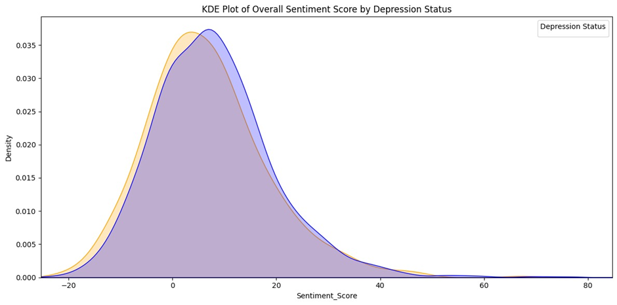
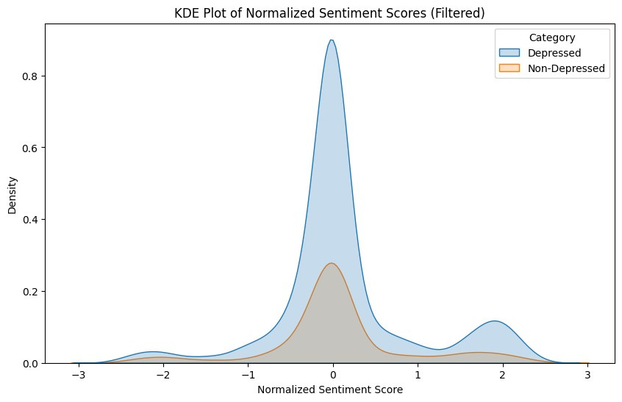
SENTIMENTAL SCORE
1st graph shows the Sentimental score for all text
2nd graph is normalized Sentimental score for depressed vs Non Depressed
we cannot find any relation between depressed vs non depressed from the above graphs

Slide 22
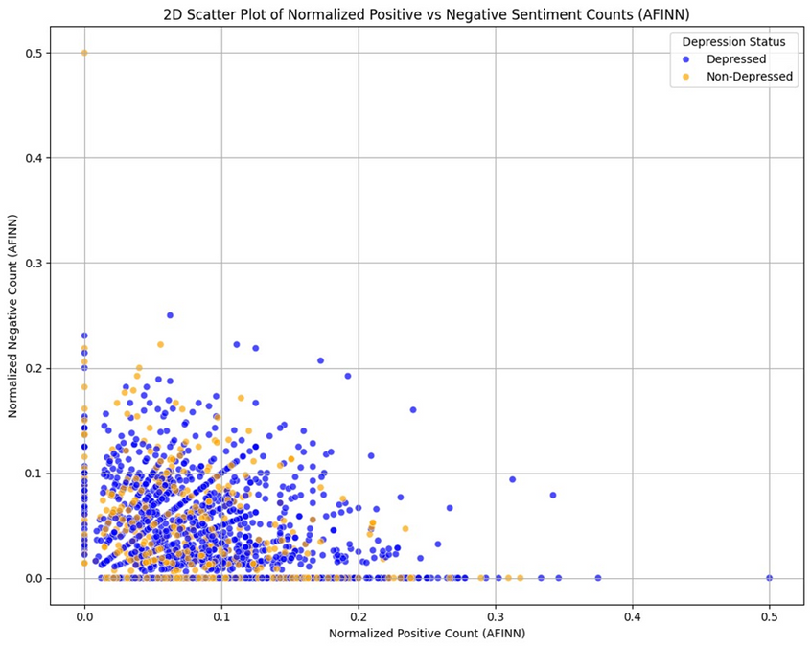
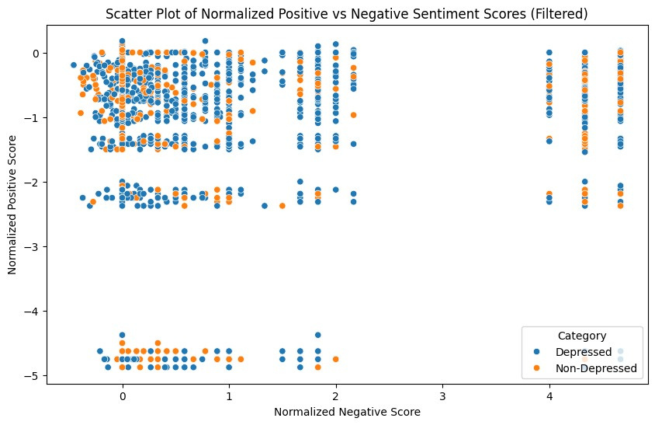
NORMALIZED POSITIVE VS NEGATIVE SCORE AND COUNT
1st graph is normalized positive vs negative count
2nd graph is normalized positive vs negative score

Slide 23
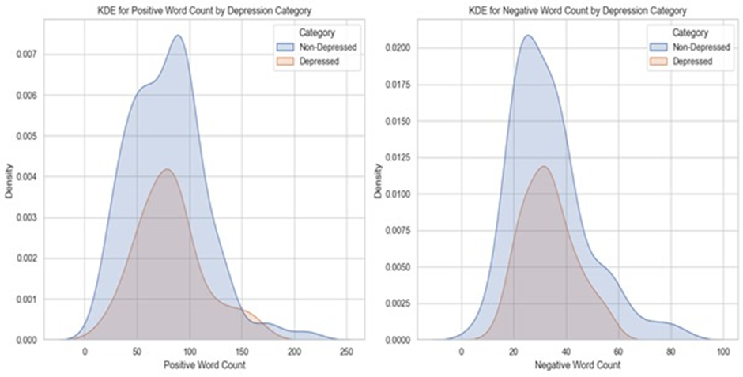
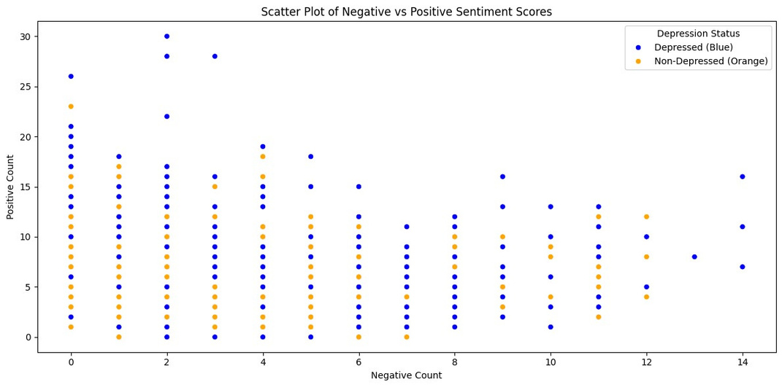
POSITIVEVS VS NEGATIVE COUNT
1st graph shows the Positive Word and Negative Word count for all text
2nd graph shows the Positive Word and Negative Word count for all text using Scatter plot
we cannot find any relation between depressed vs non depressed from the above graphs

Slide 24
SENTIWORDNET
SentiWordNet is a lexical resource that assigns sentiment scores to Text. These scores indicate the degree of positivity, negativity associated with the synsets.
Sentiment Scores: For each synset, SentiWordNet provides three scores:
Positive Score: The degree to which the synset expresses positive sentiment.
Negative Score: The degree to which the synset expresses negative sentiment.
Score is from 0 to 1.

Slide 25
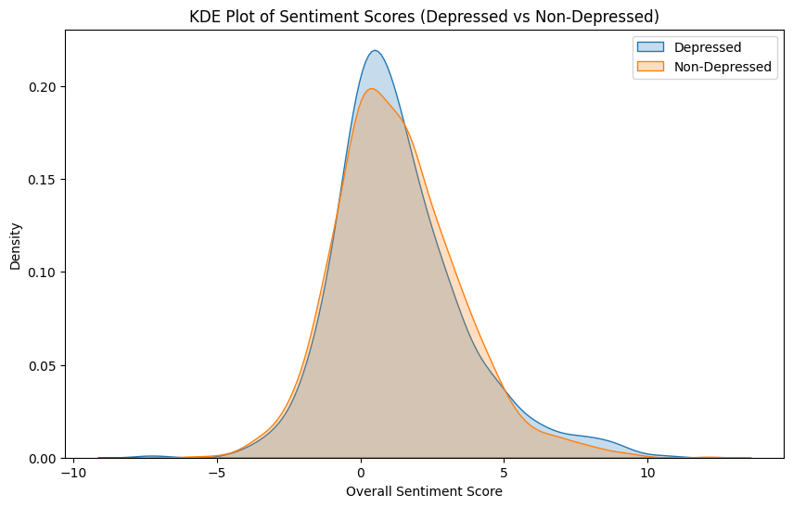
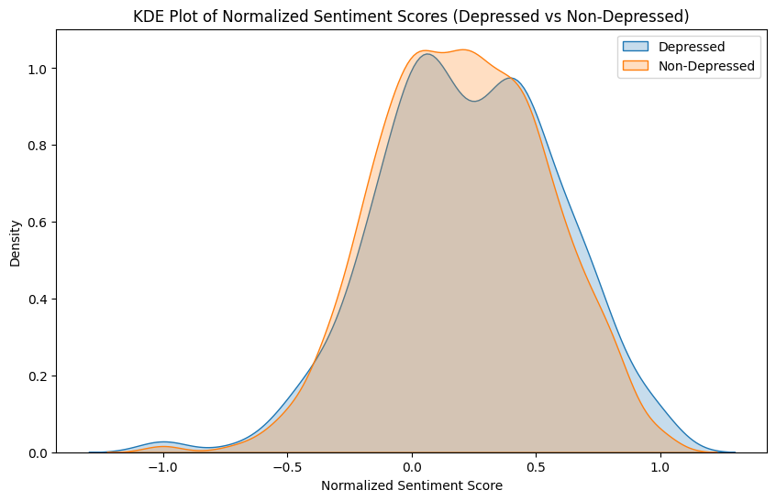
SENTIMENT SCORE

Slide 26
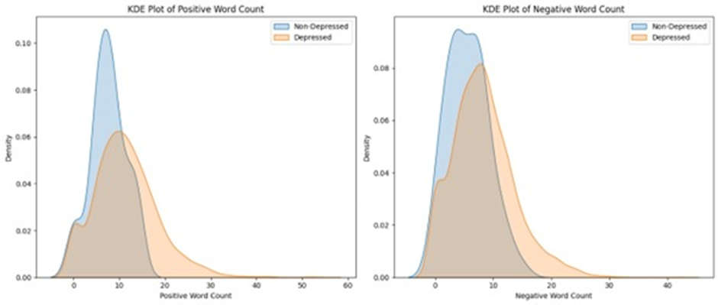
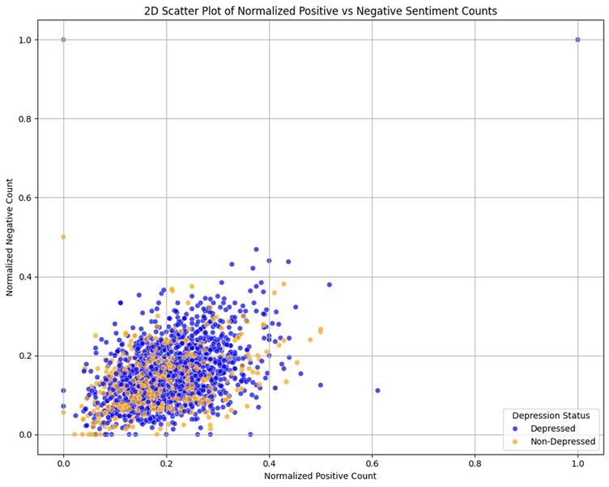
POSITIVE VS NEGATIVE WORD COUNT

Slide 27
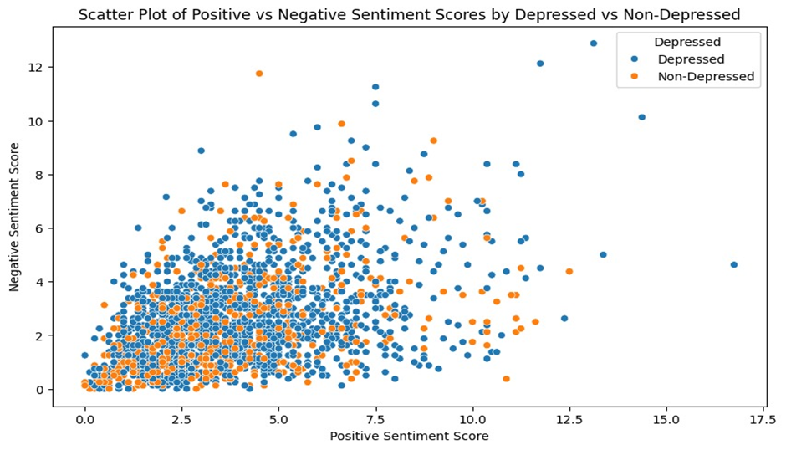
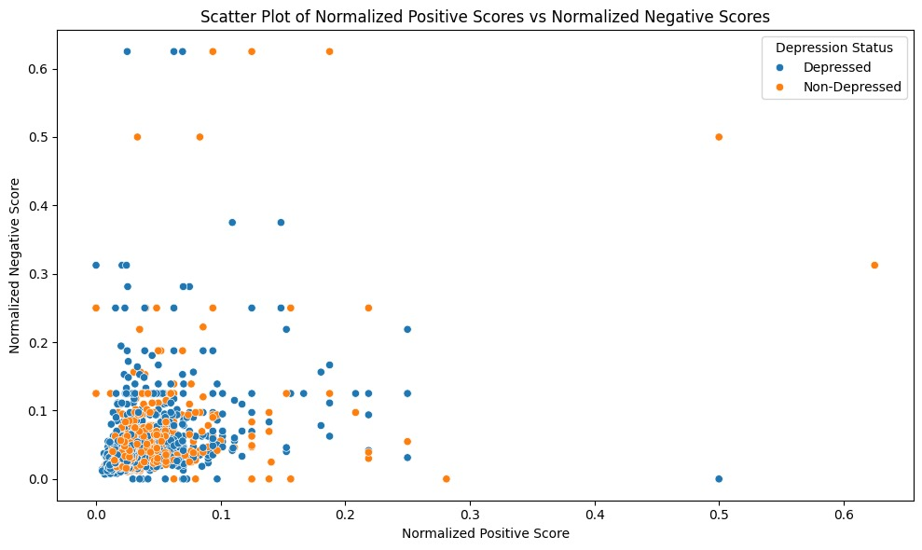
POSITIVE VS NEGATIVE SCORE

Slide 28
DATASET-2

Slide 29
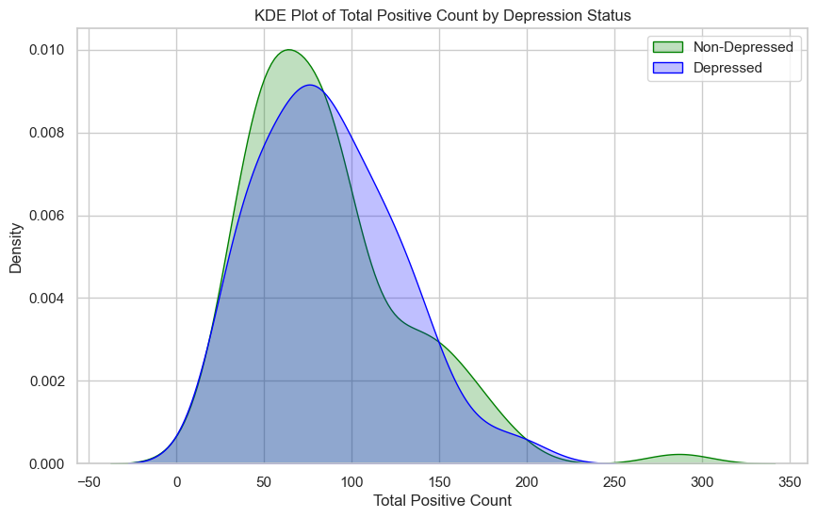
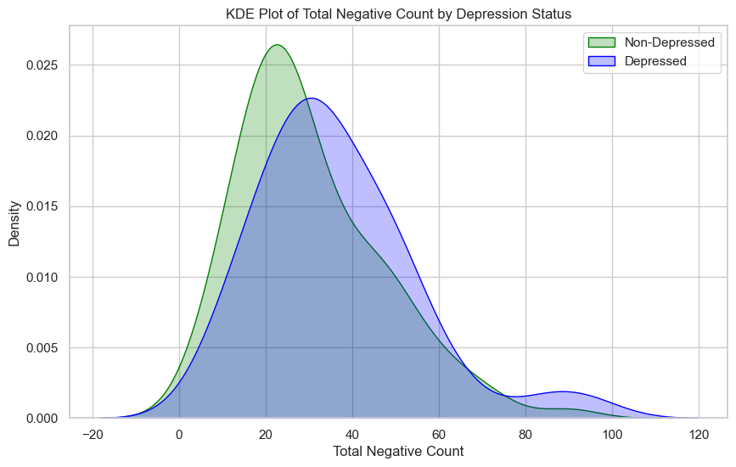
POSITIVE AND NEGATIVE COUNT
In this dataset each participant was asked a series of questions by interviewer and recorded thier responses so we have taken the full response of each participants and plotted the graphs

Slide 30
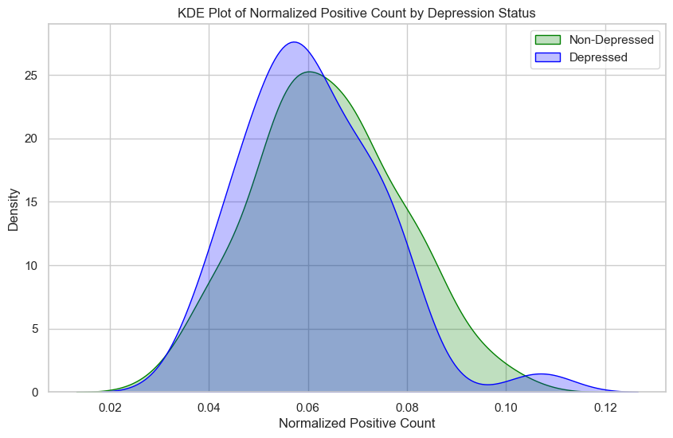
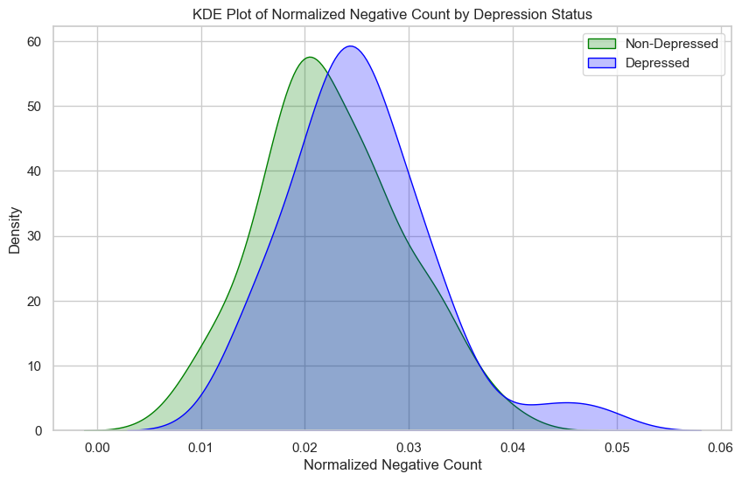
NORMALISED NEGATIVE AND POSITIVE COUNT
Normalized Positive count=Positive word count/total word count
Normalized Negative count=Negative word count/total word count

Slide 31
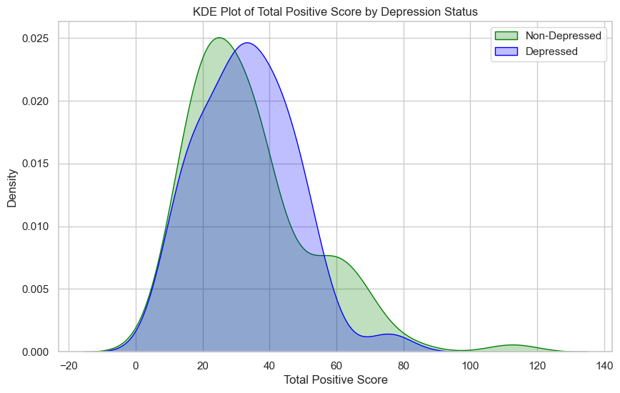
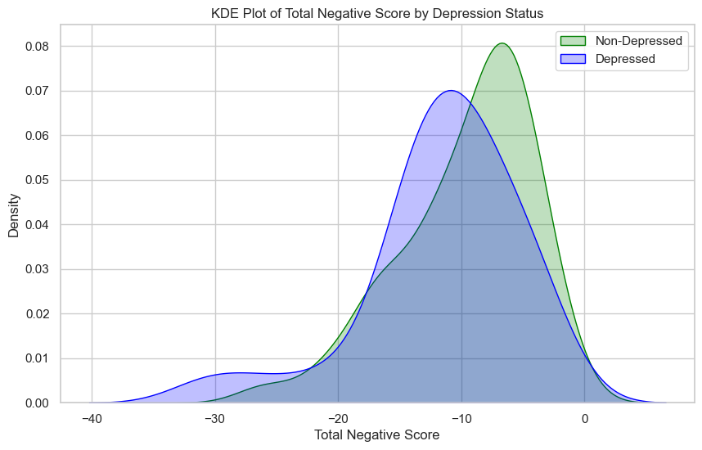
POSITIVE AND NEGATIVE SCORE
The first graph shows the Positive Score for full Response of Each Participant
Second graph shows the Negative score for full Response of each Participant

Slide 32
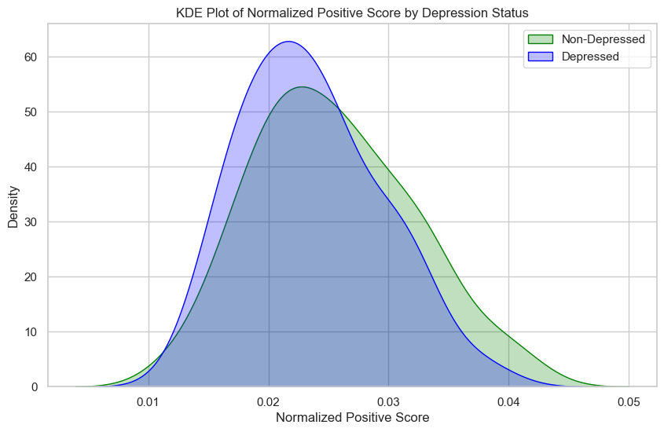
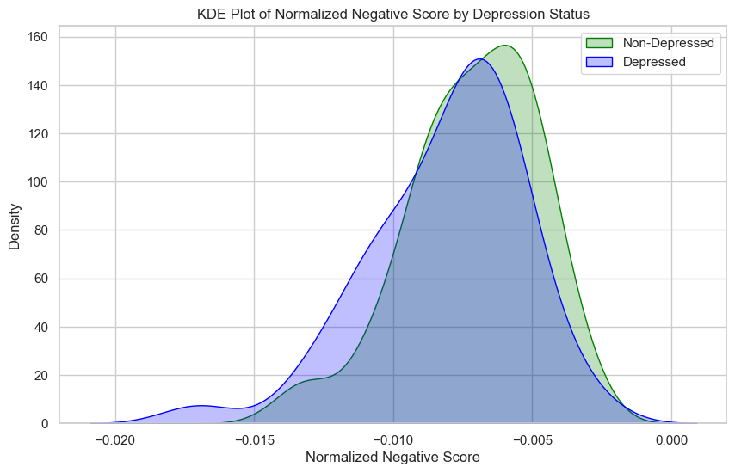
NORMALISED POSITIVE AND NEGATIVE SCORE
The first graph shows the Normalised Positive Score for full Response of EachParticipant
Second graph shows the Normalised Negative score for full Response of each Particpant
Normalised score =Score/total word count

Slide 33
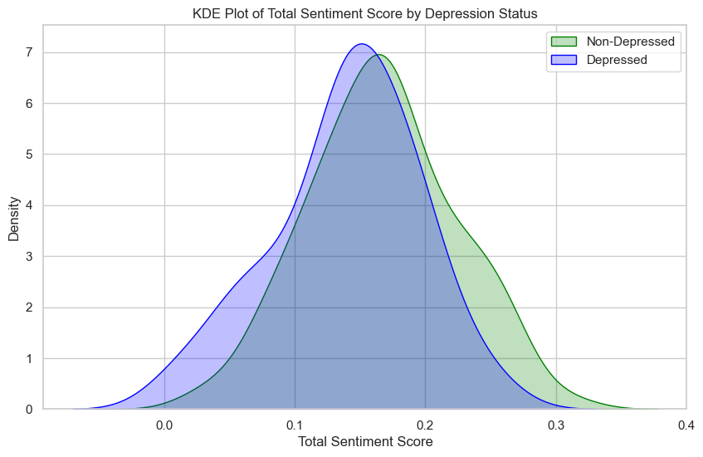
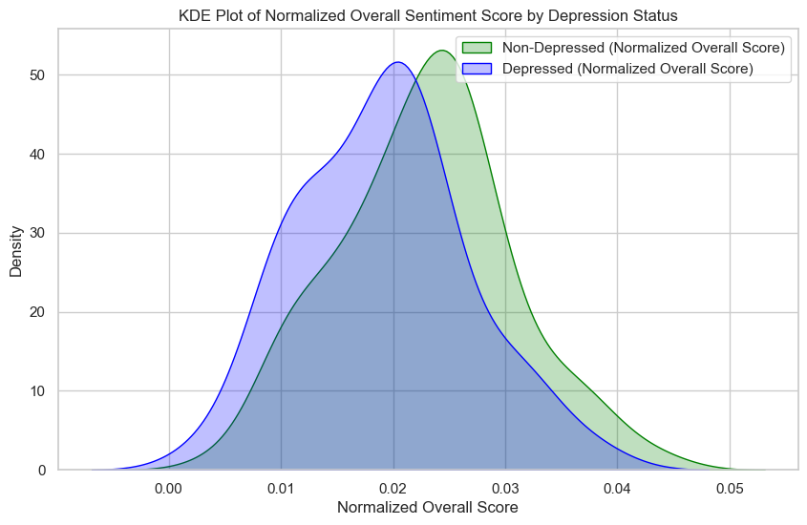
SENTIMENT SCORE AND NORMALISED SENTIMENT SCORE
The first graph shows the Sentiment score for full Response of EachParticipant
Second graph shows the Normalised Sentiment score for full Response of each Particpant

Slide 34
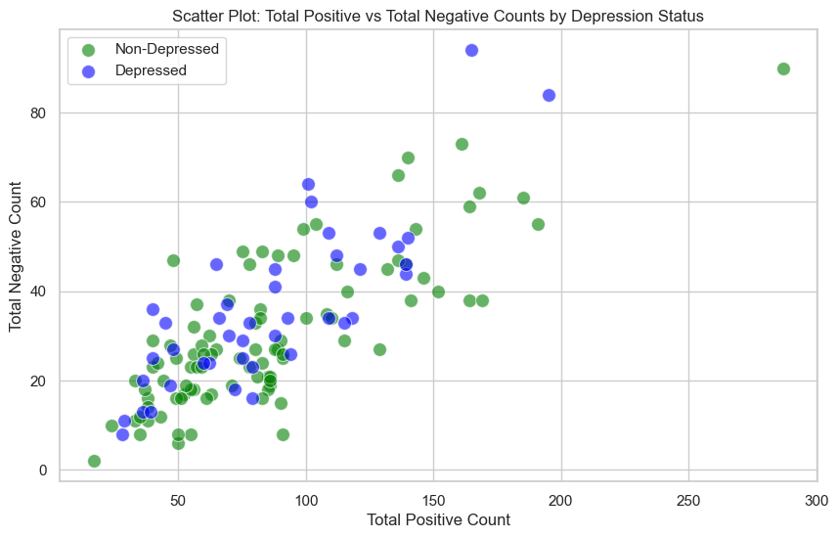
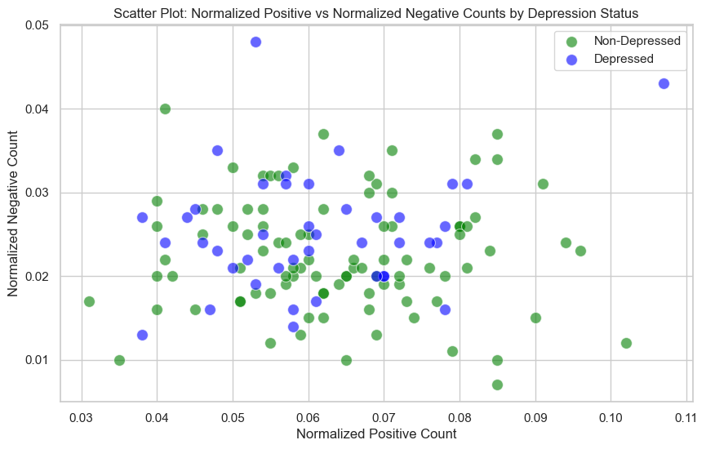
SCATTER PLOT FOR POSITIVE AND NEGATIVE COUNT AND NORMALIZED COUNT

Slide 35
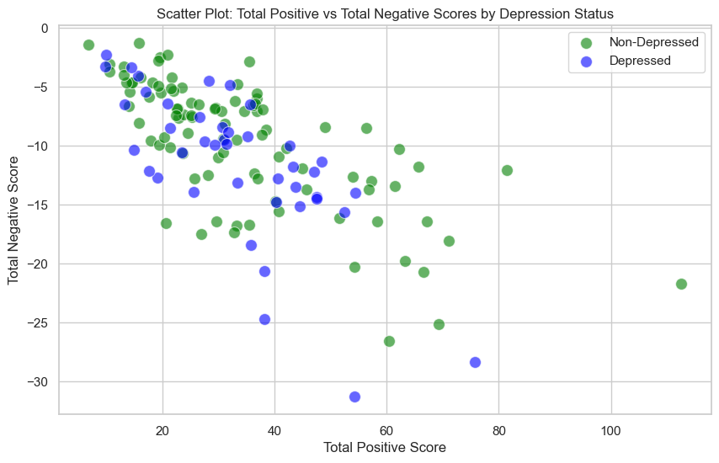
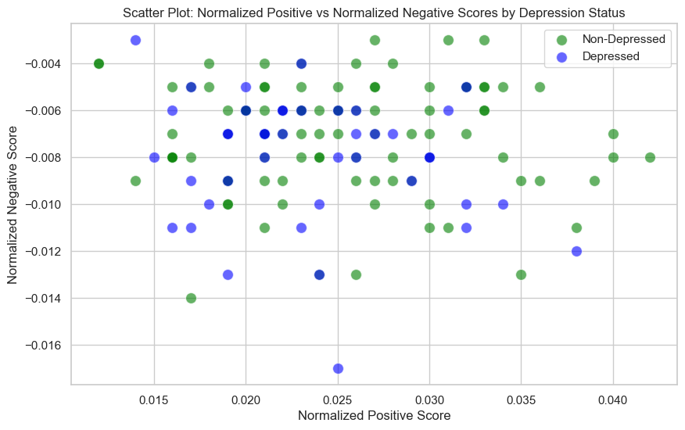
SCATTER PLOT FOR POSITIVE AND NEGATIVE SCORES AND NORMALISED SCORES

Slide 36
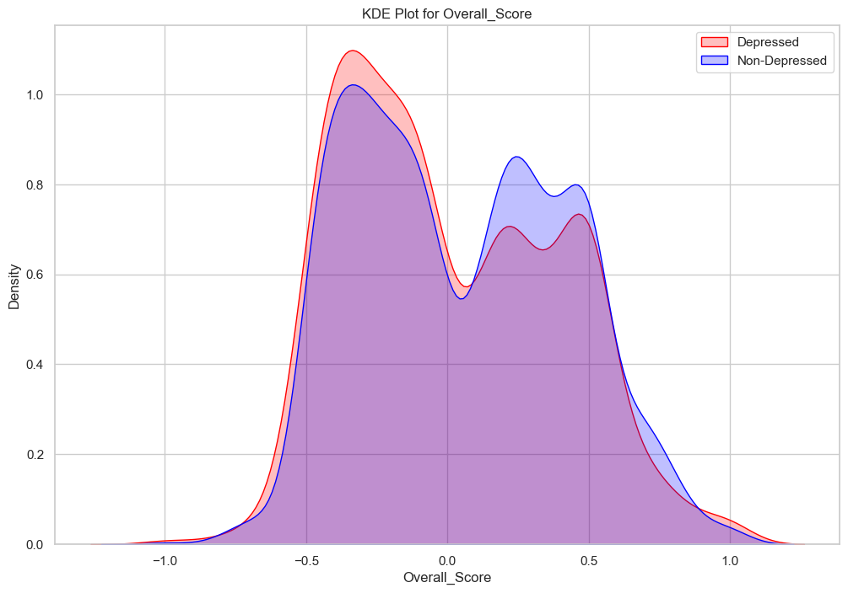
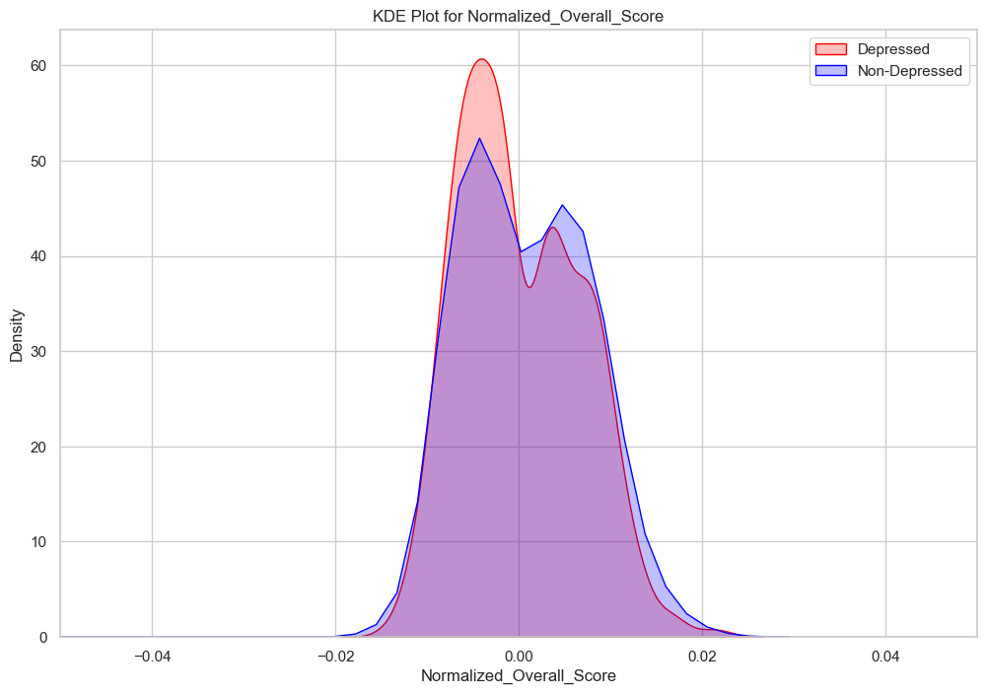
OVERALL SENTIMENT SCORE FOR EACH RESPONSE
Each participant was asked a series of questions, and the sentiment score for each response was analyzed using TextBlob.
The normalization was performed by calculating the sum of the sentiment scores for each participant responses and dividing it by the total number of responses provided by that participant

Slide 37
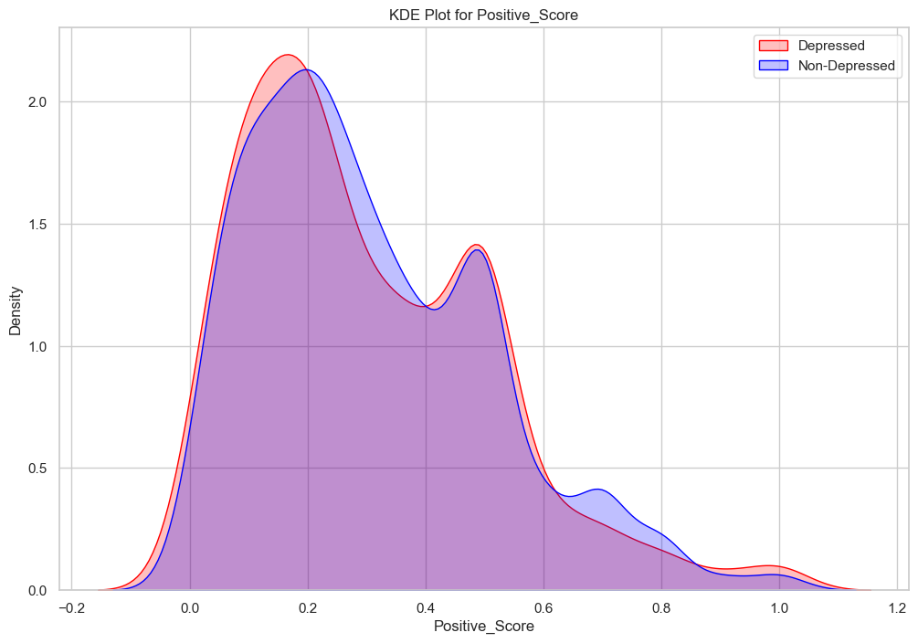
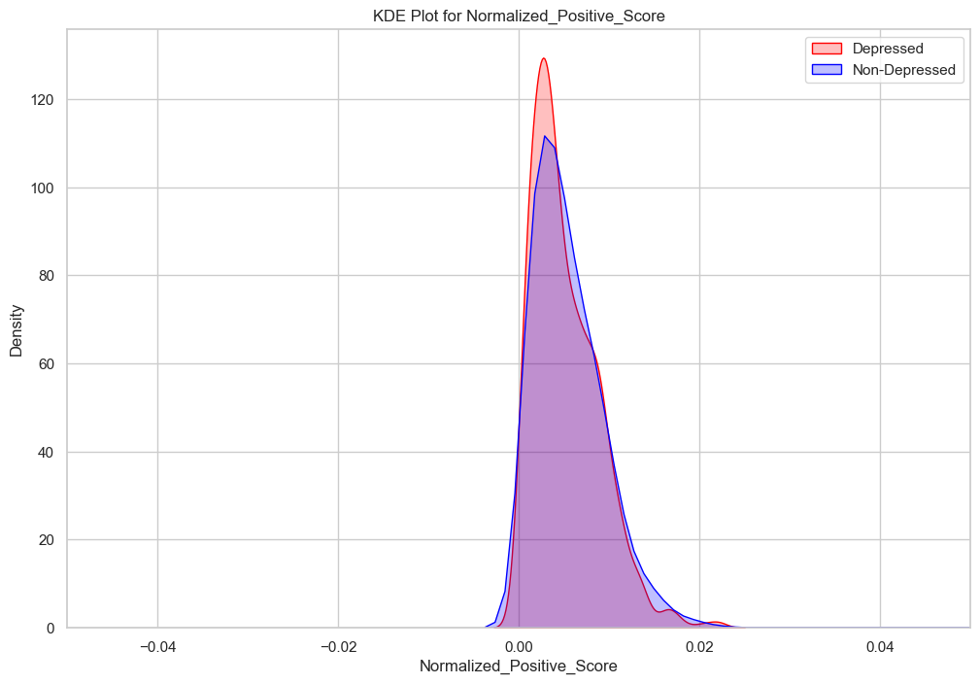
POSITIVE SCORE FOR EACH RESPONSE
In this we have taken only the positive score of each responses
The second graph show the normalized positive score

Slide 38
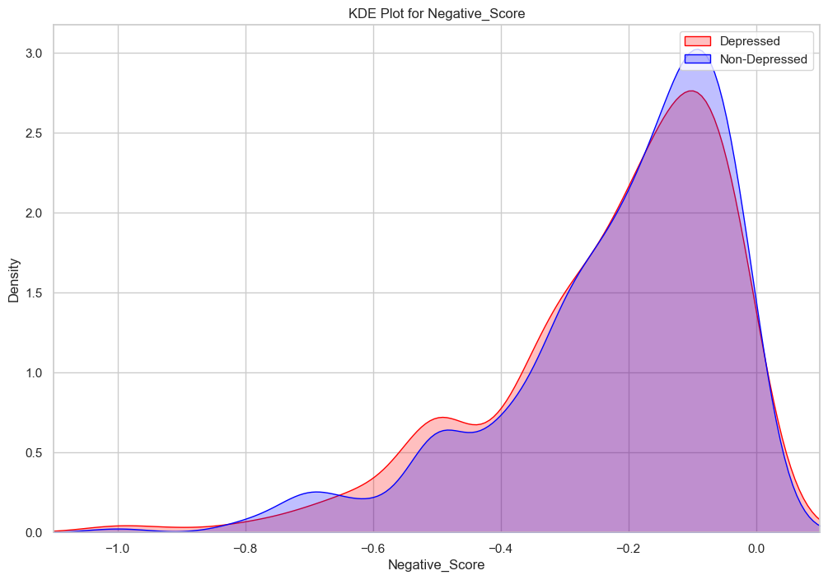

NEGATIVE SCORE FOR EACH RESPONSE
In this we have taken only the negative score of each responses
The second graph show the normalized negative score

Slide 39


POSITIVE AND NEGATIVE COUNT FOR EACH RESPONSE
In this we have taken only the number of positive words in each responses
The second graph show the number of positive words in each responses

Slide 40
AROUSAL AND VALANCE
FOR DATASET 1

Slide 41


AROUSAL AND VALANCE SCORE FOR ALL SENTENCE
We used the NRC VAD lexicon, which provides predefined valence (positivity) and arousal (energy level) scores. We compared these scores to classify emotional states ranging from calm to excited or subdued.
Here we have Plotted valance and aurosal score for all Sentences

Slide 42

AVG AROUSAL AND VALANCE SCORE
In this graph we have taken the Average valance and Average Aurosal
There are 15 Transcripts for each Participant So we have taken the Average by dividing it with by15 we got the Average Valance and Average Aurosal plot

Slide 43


NORMALISED AROUSAL AND VALANCE SCORE FOR ALL SENTENCE
In this graphs we have Normalised the Valance and Aurosal Score
Normalised Valance and Aurosal are taken by the Sum of Scores and dividing it with total word count for all Sentneces
We have plotted Four graphs and thier Combinations both Kde and Scatter Plots

Slide 44


NORMALISED AROUSAL AND VALANCE SCORE FOR ALL SENTENCE

Slide 45

NORMALISED AROUSAL AND VALANCE COUNT FOR ALL SENTENCE
BEST THRESHOLD 0.41
In this graph we have taken a Threshold value between 0 and 1
we have set a threshold and Normalised and Using EER method We have calculated the Thresholds and Compared Which threshlold has the Best EER
0.41 is the threshold we have taken it has the best EER Among other thresholds

Slide 46
DATASET-2

Slide 47


VALANCE SCORE FOR EACH RESPONSES
In this we have taken valence score for each response of participant
The second graph show the normalized that is by taking the sum of valence score of each participant and dividing it by number of responses by that participant

Slide 48


AROUSAL SCORE FOR EACH RESPONSES
In this we have taken arousal score for each response of participant
and second graph show the normalized that is by taking the sum of arousal score of each participant and dividing it by number of responses by that participant

Slide 49

VALENCE AND AROUSAL COUNT FOR EACH RESPONSE AT THRESHOLD=0.46(EER)
We performed the Equal Error Rate (EER) method and determined the optimal threshold to be 0.46. Using this threshold, we classified valence and arousal scores: values above 0.46 were labeled as high valence and high arousal, while values below 0.46 were labeled as low valence and low arousal. The following graph was then plotted for each participant's each response based on these classifications

Slide 50


VALENCE SCORE FOR PARTCIPANT
In this we have taken the valence score as participant level and the second graph give normalized valence score, that is by taking the valence score divided by the total word count

Slide 51


AROUSAL SCORE FOR PARCIPANT
In this we have taken the arousal score as participant level and the second graph give normalized arousal score, that is by taking the arousal score divided by the total word count

Slide 52

VALENCE AND AROUSAL COUNT FOR PARTCIPANT AT A THRESHOLD=0.46(EER)
We performed the Equal Error Rate (EER) method and determined the optimal threshold to be 0.46. Using this threshold, we classified valence and arousal scores: values above 0.46 were labeled as high valence and high arousal, while values below 0.46 were labeled as low valence and low arousal. The following graph was then plotted for each participant's based on these classifications

Slide 53
LLM -Large Language Models
DistilBERT-base-uncased-finetuned-sst-2-english is a pre-trained transformer model developed by Hugging Face that is a smaller, faster, and lighter version of BERT. It has been fine-tuned on the Stanford Sentiment Treebank (SST-2) dataset, which is designed for sentiment analysis tasks
We have utilized Llama models for this analysis, leveraging their compact size and efficiency to achieve robust performance in our natural language processing tasks

Slide 54


MISSCLASSIFICATIONS- MODELS AGAINST PHQ
Using TINYLlama
Using GPT-4

Slide 55

MISSCLASSIFICATIONS- MODELS AGAINST PHQ
Using Bert -SST-2

Slide 56

TINYLlama
TinyLlama/TinyLlama-1.1B-step-50K-105b

Slide 57


POSITIVE AND NEGATIVE SENTIMENT COUNT FOR EACH RESPONSE
distilbert-base-uncased-finetuned-sst-2-english
Here the model will give the the label
For the Response as Positive or Negative
Confident Score ranges from 0 to 1

Slide 58


POSITIVE VS NEGATIVE SCORE EACH RESPONSE USING BERT MODEL

Slide 59

POSITIVE AND NEGATIVE COUNT PERPARTCIPANT
positive and negative count of response by each participant in dataset 1(15 response by each participant using distilbert-base-uncased-finetuned-sst-2-englis

Slide 60
CONCLUSION
In our analysis, we found no significant correlation between positive and negative word counts and emotional scores, primarily due to the limited emotional content extraction with available tools for Sentimental analysis. The fixed set of words may not fully capture the complexity of emotional expressions, especially in depressed individuals who might conceal their true feelings. Utilizing large language models (LLMs) could improve our results by providing a deeper understanding of emotional content in sentences leading to more accurate insights in future analyses.

Slide 61

Thank
You

